Slide 1
BAYES THEOREM
a bold adventure

Slide 2
Deriving Bayes Theorem
We know: P(A | B) = P(A ∩ B) / P(B)

Slide 3
Deriving Bayes Theorem
We know: P(A | B) = P(A ∩ B) / P(B)
We also know, from product rule, P(A ∩ B) = P(B|A) * P(A)

Slide 4
Deriving Bayes Theorem
We know: P(A | B) = P(A ∩ B) / P(B)
We also know, from product rule, P(A ∩ B) = P(B|A) * P(A)
And we know that if A1 . . . An are disjoint,
P(B) = Σi P (B | Ai) * P(Ai)

Slide 5
Deriving Bayes Theorem
We know: P(A | B) = P(A ∩ B) / P(B)
We also know, from product rule, P(A ∩ B) = P(B|A) * P(A)
And we know that if A1 . . . An are disjoint,
P(B) = Σi P (B | Ai) * P(Ai)
Put it all together:
P( A | B) = P(B | A) * P(A)
__________________________________
Σi P (B | Ai) * P(Ai)

Slide 6
Using Bayes Theorem
Bayes Theorem: P(A | B) = P(B | A) * P(A) = P(B | A) * P(A) __________________________________________ _________________________________________
P(B) Σi P(B | Ai) * P(Ai)

Slide 7
Using Bayes Theorem
Bayes Theorem: P(A | B) = P(B | A) * P(A) = P(B | A) * P(A) __________________________________________ _________________________________________
P(B) Σi P(B | Ai) * P(Ai)
Politics example - Given that a voter was in favor of military spending, what is the likelihood they are a Democrat?

Slide 8
How does it change our thinking?

Slide 9
How does it change our thinking?
Hypothesis and Data:
P(H|D) = P(D|H) * P(H) _ ___________________________________
P(D)

Slide 10
How does it change our thinking?
Hypothesis and Data:
P(H|D) = P(D|H) * P(H) _ ___________________________________
P(D)
Prior = P(H) = probability H is true before considering data

Slide 11
How does it change our thinking?
Hypothesis and Data:
P(H|D) = P(D|H) * P(H) _ ___________________________________
P(D)
Prior = P(H) = probability H is true before considering data
Posterior = P(H|D) = prob. H is true after considering data

Slide 12
How does it change our thinking?
Hypothesis and Data:
P(H|D) = P(D|H) * P(H) _ ___________________________________
P(D)
Prior = P(H) = probability H is true before considering data
Posterior = P(H|D) = prob. H is true after considering data
Likelihood = P(D|H) = evidence about H provided by data

Slide 13
How does it change our thinking?
Bayesian thinking:
Frequentist thinking:
VS.

Slide 14
How does it change our thinking?
Bayesian thinking:
Frequentist thinking:
Given what we know about prior probabilities, what is the probability of what we’ve seen?
VS.

Slide 15
How does it change our thinking?
Bayesian thinking:
Frequentist thinking:
Given what we know about prior probabilities, what is the probability of what we’ve seen?
VS.
If we infinitely reproduce our same starting conditions, how frequently will what we’ve seen occur?

Slide 16
Which is better?

Slide 17
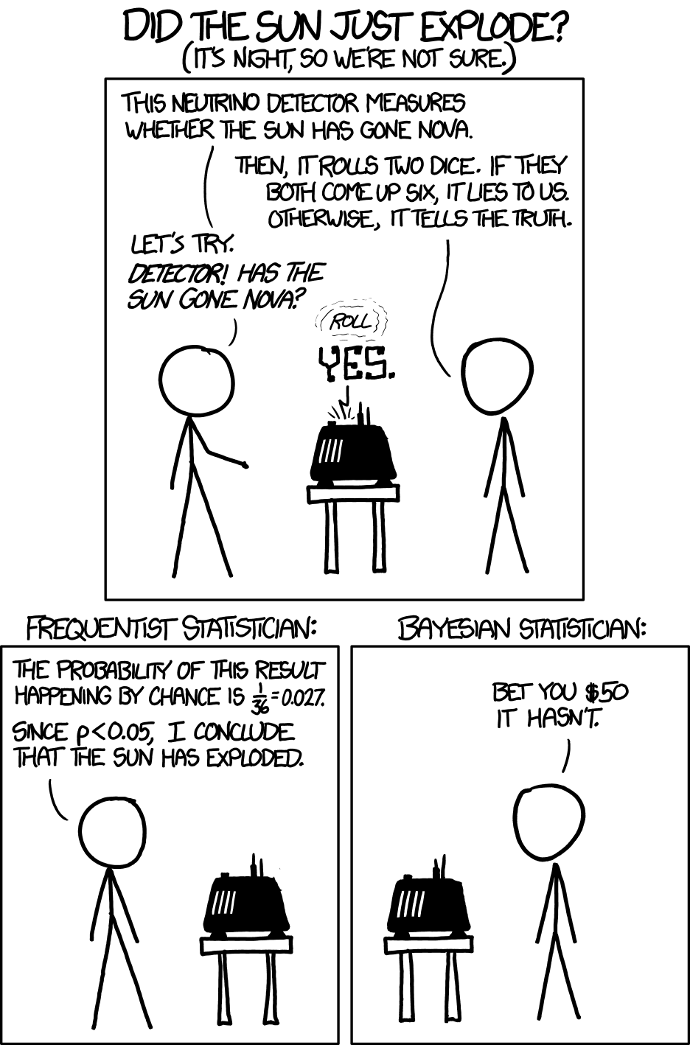
Which is better?

Slide 18
Which is better?
Bayes:
Priors are subjective
H is ‘true’ or ‘false’, no prob.
Frequentist:
Ad-hoc
Frequently mis-interpreted

